Slide 1
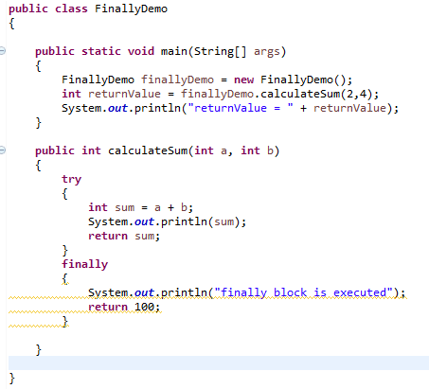
finally
Does finally block Overrides the values returned by try-catch block?
The answer is yes. This code would return value 100 since the value returned by try has been overridden by finally.

